Slide 1
Elective courses & TFG ADE & ECO english track 2022-2023
Feie: may 2022

Slide 2
4th YEAR: 60 ECTS
12 ECTS: Bachelor’s Degree Final Project (TFG)
48 ECTS: Elective courses – 6 ECTS / course (excluding internship programme)
Curricular internship programme 18 ECTS English credit recognition: 1,5 credit granted per each 6CTS course passed in English up to a maximum of 12 ECTS (application at Gestió Acadèmica)
Students in the ADE/ECO english track MUST enrol in courses offered in english
Menció en anglès requires you do so

Slide 3
Internship programme BCN Activa
Prerequisites
A minimum of 150 ECTS already passed
All freshman year courses already passed
18 ECTS available
Application by june 1st (link sent by e-mail from Deganat)
Admission into the programme and mail with directions aproximately end of june
https://www.uab.cat/doc/internship-feie-bcn-activa
Contact:
Prof. Valeri Sorolla

Slide 4
Final Year Project (TFG)
Information available at: www.uab.cat/economia-empresa ‘TFG’
INFORMATIVE SESSION OCTOBER 2022
To be able to enroll in TFG students need to have passed:
All freshman year courses
A minimum of 160 ECTS
A minimum of 120 ECTS in 1st,2nd and 3rd year courses
Recommendation
Enroll in TFG the academic year you expect to finish your grade/ BBA
If you want to deliver your TFG during the 1st term
Contact Gestió Acadèmica

Slide 5
About FINAL YEAR PROJECT (TFG)
Pre-set list of topic/tutor published by mid-October, students choose:
title of the project & name of tutor
Students choose according to grade point average (GPA).
Grading:
If the grade is 7 or more the tutor assigns a 7.
A student that has a 7 can choose to participate in the Poster Sessions (creating a poster and defending it in front of a committee formed by faculty members).
The Committee can add up to 3 additional points.

Slide 6
GENERAL INFO ON ELECTIVE COURSES
Check timetables (by end of June) at:
www.uab.cat/economia-empresa (click on ‘Horaris i Aules’ button)
Limited enrollment - students enroll according to grade point average (GPA)
Grading in elective courses (excluding Internship course) detailed in the study guide.
Students in the ADE/ECO english track MUST enrol in courses offered in english
Menció en anglès requires you do so

Slide 7
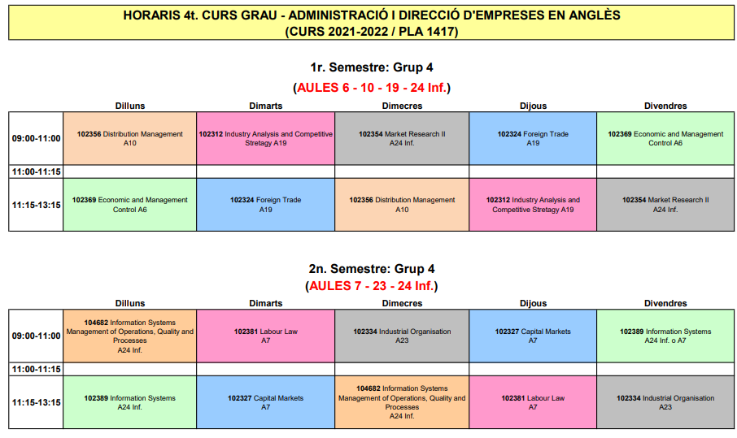
Which electives can I choose?
Elective courses offered may change from year to year
According to each grade: ECO/ADE english track, check “plan d’estudis”
ADE https://www.uab.cat/doc/pla_grau_adeang
ECO https://www.uab.cat/doc/pla_grau_eco_ang
According to the semester (1st or 2nd) and “shift” (morning / afternoon)
Check this year’s timetables as a first approach to elective courses taught in english
https://www.uab.cat/web/estudiar/graus/oferta-de-graus/horaris-i-aules-curs-2021-2022-1345693121190.html
Careful!!!
2021-22 electives

Slide 8
To keep in mind
Check courses timetables and syllabi
Check exam dates to avoid overlapping
The exams calendar is set so as to avoid overlapping among 3rd and 4th year courses
In case of having to enroll in 2nd year courses, either choose a diferent elective or enroll in afternoon classes
If, and only if, this is not possible, students must contact grade coordinators to check on rescheduling
Remember to keep updated on TFG related issues – allocation System, activities calendar, etc.

Slide 9
FEiE exam rescheduling: circumnstances under which rescheduling is granted
EXAM RESCHEDULING REQUEST Exam rescheduling is restricted to a serious medical or psychological condition (surgeries, accidents and other serious situations), legal affairs (with official subpoena or court order), official affairs (examinations to become a civil servant) and the decease of a close family member. In all cases, supporting documents will be attached. In the case of a medical justification, if reporting minor problems that may have different intensities, the certificate should specify that the student is not in a position to take an exam. The official exam calendar is published before the beginning of the course. Therefore, work-related circumstances and those derived from participation in mobility programs will not be considered a valid reason. Personal reasons (driving tests, travelling and other) are not valid reasons either for an exam to be rescheduled. Exceptionally, during the 2021-22 academic year, in the case of a request for rescheduling exams due to the coincidence of two assessments in day and time, rescheduling may be granted within the same day in the schedule programmed by another group of the same subject. The knowledge of the teachers of the groups involved will be required. In no case may it be rescheduled on a date other than the day published by the corresponding examination, except in cases that for overwhelming reasons are already considered.
In case of overdue situations the request for reprogramming of tests must be made within 5 calendar days immediately after the date of the test. The bachelors' degree coordinator will have 48 hours to assess the request and respond. . Link to exam rescheduling request:
e-Form for exam rescheduling
All requests must be properly documented
Check FEiE web – protocol is subject to changes

